Slide 1
DO NOT SHOW
Microsoft Cloud Adoption Framework and the Governance Conversation
Speaker:
Microsoft Azure Partner
Speaker:
Primary Audience:
Cloud Architect
Primary Audience:
Impacted Audience:
Sr. IT Pro/IT Operations/Application Owners/Influencers/Decisions Markers
Impacted Audience:
Usage guide:
Usage guide:
This presentation is designed to provide a modular, brief introduction of how CAF can help organizations to manage cloud governance efforts, preferably on Azure. Use this deck to kickoff the governance discussion with your customer and introduce your own Azure offerings related to governance.
There are specific slides where your content (Partner) needs to be added.
Flow suggestion: take your customer through slides 4-24 to ensure the Governance model from Microsoft CAF for Azure is well understood. From there, assess your customer’s specific needs and continue with the MVP evolution or take them directly to your governance-related offering to lock the business opportunity. Feel free to incorporate as many slides as needed.
Additional supporting materials:
Governance Documentation Overview : https://aka.ms/adopt/govern
Governance assessment tool: https://aka.ms/adopt/gov/assess

Slide 2
DO NOT SHOW
General Information
This presentation contains several aspects – regarding governance theory and the application of governance within Azure
Please tailor it to your customer needs and incorporate your related offerings
(technical discussions, cloud adoption, cloud governance)

Slide 3
Cloud Adoption Framework for Azure Making Governance Easier
Speaker
Title

Slide 4
Agenda
Introductions
Cloud Adoption Framework Overview
Governance in Azure
Framework
Assess
MVP
Evolve
Next Steps

Slide 5
Partner overview slide
Partner overview slide

Slide 6















Business processes and people readiness are my biggest adoption blockers. How do I align with the business to get the support we need?
My team needs to better understand how cloud adoption will change governance, security, and operations.
The cloud gives us new technical capabilities. How do we integrate them into our culture to serve our customers and disrupt the industry?
Notes:
Pablo

Slide 7
Microsoft Cloud Adoption Framework for Azure
Business Strategy
Actionable, efficient, and comprehensive Azure cloud guidance from Microsoft to accelerate your adoption journey
Microsoft Cloud Adoption Framework for Azure enables you align business, people and technology strategy to achieve your business goals
Technology Strategy
People Strategy

Slide 8
Microsoft Cloud Adoption Framework for Azure
Adopt
Define Strategy
Understand motivations
Business outcomes
Business justification
Prioritize project
Plan
Digital estate
Initial organization alignment
Skills readiness plan
Cloud adoption plan
Ready
Azure readiness guide
First landing zone
Expand the blueprint
Best practice Validation
Migrate
• First workload migration
• Expanded scenarios
• Best practice validation
• Process improvements
Innovate
• Innovation guide
• Expanded scenarios
• Best practice validation
• Process improvements
Govern
Methodology • Benchmark
initial best practice • Governance maturity
Manage
Business commitments
operations baseline • Ops maturity

Slide 9

The major drivers for IT Governance
Keep risk at acceptable levels
Maintain availability to systems and services
Consistently apply policy and audit compliance
Protect customer data
Notes:
Governance is about achieving strategic objectives (performance) while meeting legal, regulatory, contractual, and other obligatory requirements often supported by policies (conformance). The goal is to achieve both in a balanced way.

Slide 10

How Do I Get Started?
Framework
Frame the conversation to mitigate tangible business risks through consistent governance
1
Benchmark
Assess current state and future state to establish a vision for applying the framework
2
MVP
Establish a Minimally Viable Product (MVP) to serve as a foundation for governance
3
Evolve
Mature with each release to align Cloud Adoption and existing IT functions
4

Slide 11
Approaching the Governance Conversation

Slide 12
How Do I Get Started?
Framework
Frame the conversation to mitigate tangible business risks through consistent governance
1
Benchmark
Assess current state and future state to establish a vision for applying the framework
2
MVP
Establish a Minimally Viable Product (MVP) to serve as a foundation for governance
3
Evolve
Mature with each release to align Cloud Adoption and existing IT functions
4

Slide 13
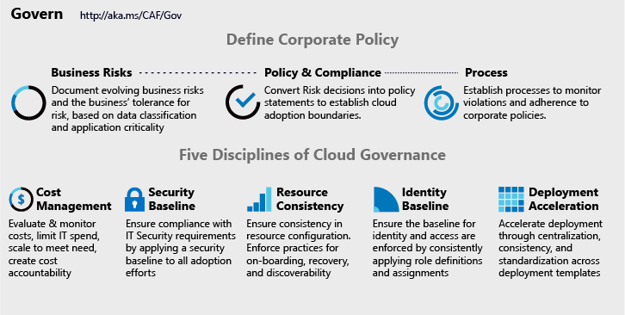
Cloud Adoption Framework - Governance
Governance End State that fosters trust and builds confidence
Corporate Policy
Governance is a big, intimidating topic. Establish proper scope by mitigating tangible risks through corporate policy.
What and Why of governance
Cloud Governance Disciplines
Governance is a team sport. Empower multiple team members by decomposing corporate policy changes into five actionable disciplines.
How of governance
Cloud Governance Team
A team of governance minded cloud architects, finance, security, operations and IT management experts can evolve these disciplines, ensure governance consistency, and accelerate deployment.
Notes:
Talk track:
The CAF model to governance is a way of approaching governance that allows us to decompose complex and emotional topics into smaller units of actionable change.
In the sections on Defining Corporate Policy, we change the topic from alignment to current IT governance requirements to a realistic look at tangible risks created by cloud adoption. Those risks can generate policy & compliance statements and recurring processes, which augment existing IT Governance Policy.
Actioning on those policy statements, is done in one of five buckets of activity that span the governance conversations. In each of the five disciplines, the Cloud Governance Team leverages the Configuration Management capabilities of the Azure Govern and Azure Manage tools to help IT Governance, IT Security, Identity, and Networking teams apply requirements consistently across all Azure adoption.
In this session, we will focus on the tools that establish a foundation for governance in Azure, which can be used to accelerate all five disciplines. These tools will aid in ensuring that the requirements of each discipline is consistently applied, audited, & enforced.

Slide 14
Making Governance actionable with native tools
Azure Blueprints
Azure Policy
Azure Cost Management
Azure Advisor
Azure Portal
Azure EA Content Pack
Azure Blueprints
Azure Policy
Resource Grouping & Tagging
Resource Manager Templates
Azure DevOps
Azure Site Recovery
Azure Backup
Azure Automation
Azure Blueprints
Azure Policy
Azure Security Center
Security Management
Threat protection
Encryption
Hybrid Identity
Azure Networking
Azure Automation
Azure Blueprints
Azure Policy
Azure Monitor
Identity
Change Tracking
DSC
Automation
Update Management
Azure Blueprints
RBAC
Azure AD
Azure AD B2B
Azure AD B2C
Directory Federation
Directory Replication
Notes:
Talking points: The five disciplines of cloud governance is a grouping of challenges faced by cloud customers (Both Azure customers and the users of other clouds). This grouping was devised and validated through direct conversations and independent studies across hundreds of hours of interviews. The five disciplines are universal to cloud users as cloud agnostic guiding principles. They are ranked in order of concern, based on user feedback.
Unfortunately, implementation of those disciplines is very cloud specific. Lets step through approaches to action on the five disciplines in Azure.
Animation 1: Configuration Management – Is the first of 2 bookends that represent the domain of the Cloud Governance Team. Cloud Governance shares many commonalities with DevOps and is rooting firmly in configuration management. Establishing a Governance MVP rooting in proper nomenclature, subscription strategies, resource grouping, and resource tagging strategies is vital. Those initial strategies (AND ALL OTHER GOVERNANCE IMPLEMENTATION) is then executed through governance tools consisting of Azure Blueprints, Azure Policy, Azure Resource Manager Templates, Azure Management Groups, and Azure Resource Groups. Master these tools and concepts and incremental governance will flow smoothly.
Additional partners in this discipline should include Disaster Recovery, Business Continuity, and/or DevOps specialists, when available.
Animation 2: Identity is still the domain of identity experts. As identity policies and requirements are defined, governance tooling and processes from the Configuration Management discipline can govern application of those requirements across all deployments.
Animation 3: Resource management is the domain of IT ops or Cloud operations. However, the governance team aids in identifying what needs monitoring & to what level of criticality. Governance tooling and processes from the Configuration Management discipline enforces the discoverability of assets and other operations requirements, across all deployments.
Animation 4: Security Management is the domain of IT Security or Cyber Security specialists. They should define all security requirements. However, the governance team aids in identifying data classifications and protection levels. Governance tooling and processes from the Configuration Management discipline enforces the application of security requirements, across all deployments.
Animation 5: Cost Management is the second book end for the domain of the Cloud Governance Team. It is also one of the most common concerns among customers. Just as configuration management is important to rapid governance implementation. Azure Cost Management or Cloudyn is important for control of costs in the cloud. Providing a holistic view of spend and a centralized means of controlling spend is a very important aspect of Cloud Governance. In fact, it is commonly the first and clearest justification for investments in Cloud Governance.
Cloud governance depends on a partnership with many teams. Likewise, those teams will come to depend on Cloud Governance for comprehensive and swift application of policy across cloud solutions. This model helps better align corporate policy to governance actions and the impacted teams.

Slide 15
Integrating 3rd Party Tools
Process 3rd parties
OpsCompass
Cost Management 3rd parties
Deployment 3rd parties
Nagios, Terraform
Could align to devops tools like Chef, Puppet, etc…
Security baseline 3rd parties
Splunk
ServiceNow
Discovery, onboarding, and recovery 3rd parties
3rd party identity providers
Notes:
What third parties can be used to accomplish similar goals?

Slide 16
Pop Quiz
What is the most common reason for adoption blockers?
Business Justification
Organization Readiness
Technical Capability
Which of the following risks lead to adoption blockers?
Interruption to the business
Data or privacy leaks
Unexpected cloud costs
Which of the following help prevent loss of data?
Mature security baseline
Resource consistency
Azure Blueprints & Policy
How do Azure Blueprints and Policy help with data leaks?
They are security tools
They are tools to block attacks or intrusion
They are tools which consistently apply security and operations requirements
Notes:
For each of these questions, assume the Cloud Adoption Team and Cloud Governance Team are in the room for planning discussions.

Slide 17
Assessing the Situation

Slide 18
How do I get started?
Framework
Frame the conversation to mitigate tangible business risks through consistent governance
1
Assess
Assess current state and future state to establish a vision for applying the framework
2
MVP
Establish a Minimally Viable Product (MVP) to serve as a foundation for governance
3
Evolve
Mature with each release to align Cloud Adoption and existing IT functions
4

Slide 19
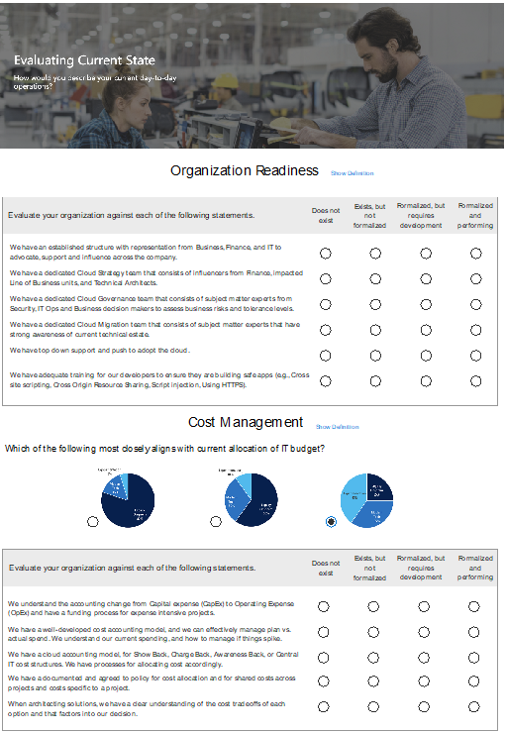
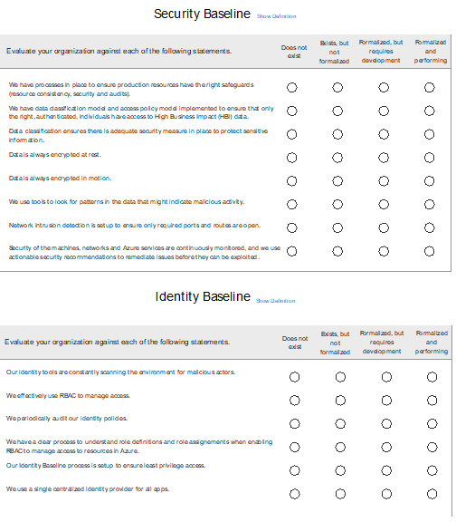
Understand the business vision driving cloud adoption
Cloud Governance Benchmark tool

Slide 20
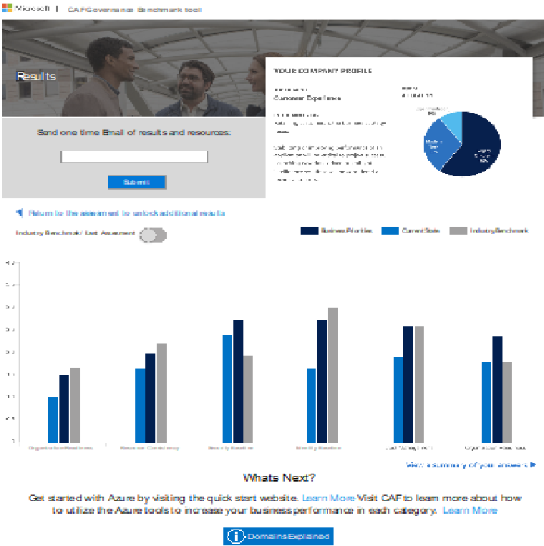
Evaluating current state
Cloud Governance Benchmark tool
Security management appears to be an important area of focus for this customer.

Slide 21
Pop Quiz
If a customer has a big gap around security baselines, who do you want to engage?
IT or Cyber Security
IT or Cloud Operations
Finance
If a customer has a big gap around cost management, who do you want to engage?
IT or Cyber Security
IT or Cloud Operations
Finance
X
If a customer has a big gap around resource consistency, who do you want to engage?
IT or Cyber Security
IT or Cloud Operations
Finance
Your customer is on O365 & is new to Azure, what’s the fastest way to mature the identity baseline?
AD running on a VM in Azure
AD Sync to new Azure AD Tenant
Existing Azure AD Tenant
Notes:
For each of these questions, assume the Cloud Adoption Team and Cloud Governance Team are in the room for planning discussions.

Slide 22
Discussion – Establishing a cloud governance MVP

Slide 23
How do I get started?
Framework
Frame the conversation to mitigate tangible business risks through consistent governance
1
Assess
Assess current state and future state to establish a vision for applying the framework
2
MVP
Establish a Minimally Viable Product (MVP) to serve as a foundation for governance
3
Evolve
Mature with each release to align Cloud Adoption and existing IT functions
4

Slide 24
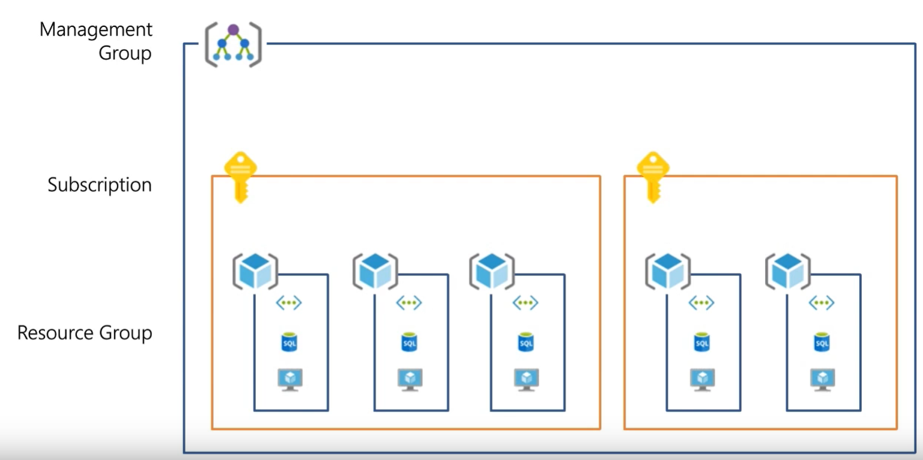
[Example]
Resource Consistency | Organization
The Foundation of all governance practices
Management Groups: To reflect security, operations and business/accounting hierarchies
2. Subscriptions: To group similar resources into logical collections
3. Resource Groups: To further group applications or workloads into deployment and operations units
Notes:
Example of an MVP for resource consistency.

Slide 25
[Example]
Resource Consistency | Organization
Architecture and Tools to govern resources
Policy Definitions
Role-based Access
Resource Manager Templates
Environment Factory: Deploy and update cloud environments in a repeatable manner using composable artifacts
Management Groups
Subscriptions
Azure Portal
SDK
3rd party
Resource Groups
CRUD
Query
Azure Blueprints
Policy Engine
Azure Resource Graph
Azure Resource Manager
2. Policy-based Control: Real-time enforcement, compliance assessment and remediation at scale
3. Resource Visibility: Query, explore & analyze cloud resources at scale
Virtual Machine
Storage
Network
…
Resource Provider

Slide 26
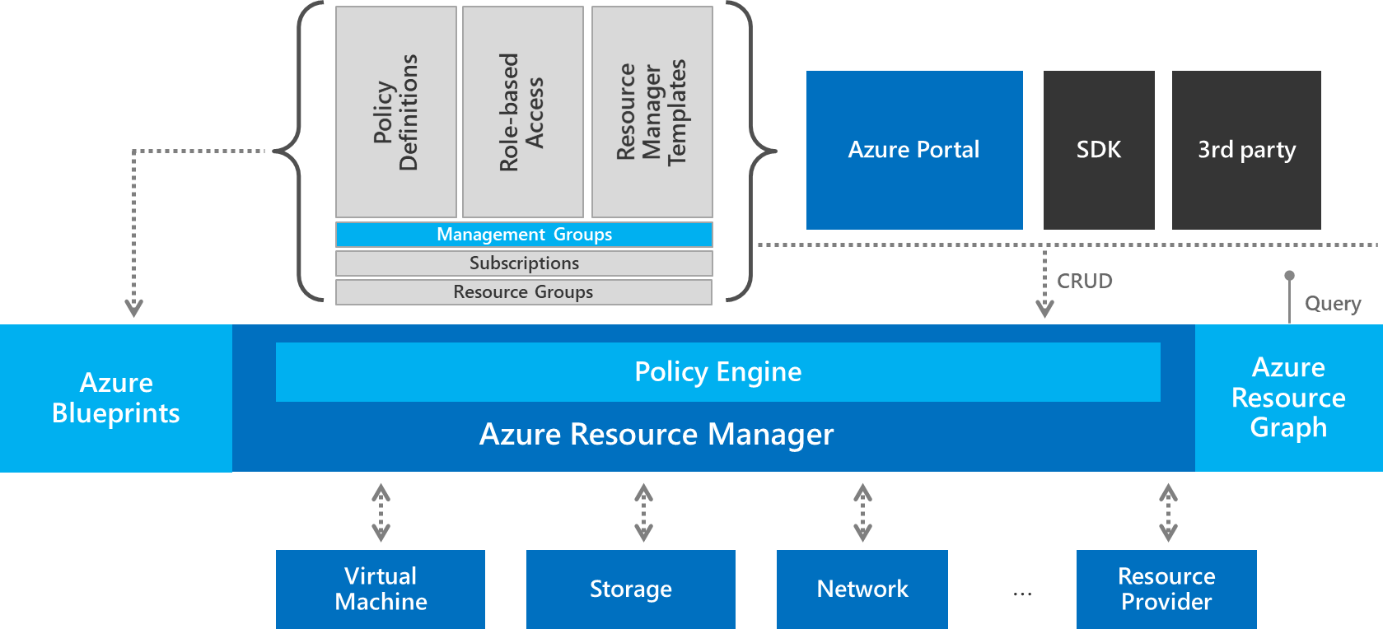
[Example]
Define a Governance MVP
Resource Governance
Resource Organization
Discussion:
How would you structure the Management Groups based on this discovery?
How would you divide subscriptions within MGs?
How would you define resource groups?
What Resource Governance Tools would you put in place?
Notes:
EXAMPLE
Current State
- Sales and operations in multiple geographies – global customer base
- Three business units
- Budget is a complex matrix across business unit and geography
- 20 privately-owned datacenters around the globe
- Loosely-coupled global WAN
- All end user email accounts are in Office 365
- The CIO and CFO want to move two data centers and 5,000 VMs in 36 mo
- There is no interest in investing in cloud governance, but a few cloud architects want to get ready for the inevitable.
IT governance policy states that customer personally identifiable information (PII), financial data, and mission critical workloads must be hosted on assets owned directly by the company. The CIO is working on changing this policy.

Slide 27
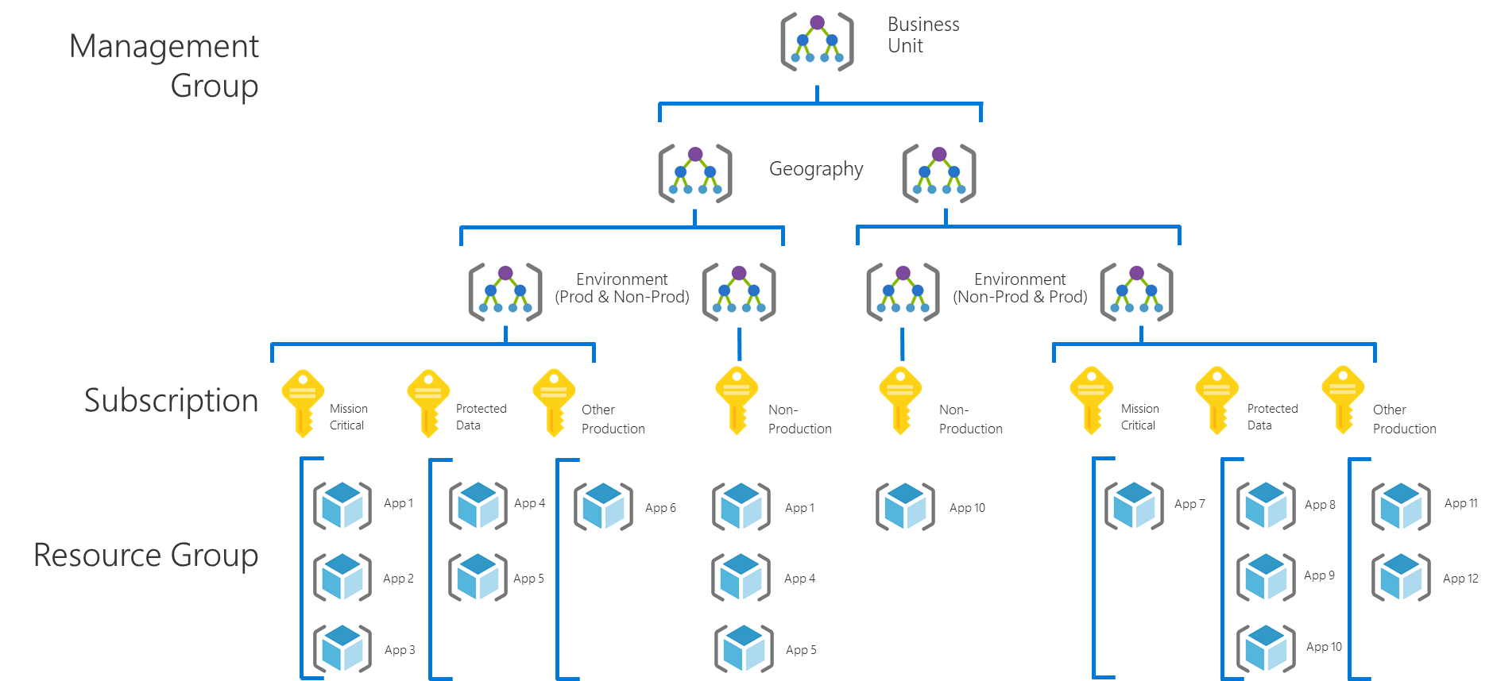
[Example]
Governance MVP
A few options to consider
Resource Governance
Create an Azure Blueprint named “Governance-MVP” .
Enforce that users can only authenticate against existing role-based access control (RBAC) implementation.
Create an Azure Policy to apply or enforce the following:
Resource tagging should require values for Department/Billing Unit, Geography, Data Classification, Criticality, SLA, Environment, Application Archetype, Application, and Application Owner.
Publish the “Governance-MVP” blueprint to each management group and assign it to each subscription
Resource Organization:
Build only what you need but grow to this hierarchy.
MG Hierarchy: Business Unit, Geography, Environment
Subscription: Per Application Category
Resource Groups: Per Application

Slide 28
Pop Quiz
Why did we create a management group per business unit?
Why did we create a management group per region?
Why do we suggest different subs for prod and non-prod environments?

Slide 29
We are here to help establish and evolve cloud governance

Slide 30
How do I get started?
Framework
Frame the conversation to mitigate tangible business risks through consistent governance
1
Assess
Assess current state and future state to establish a vision for applying the framework
2
MVP
Establish a Minimally Viable Product (MVP) to serve as a foundation for governance
3
Evolve
Mature with each release to align Cloud Adoption and existing IT functions
4

Slide 31
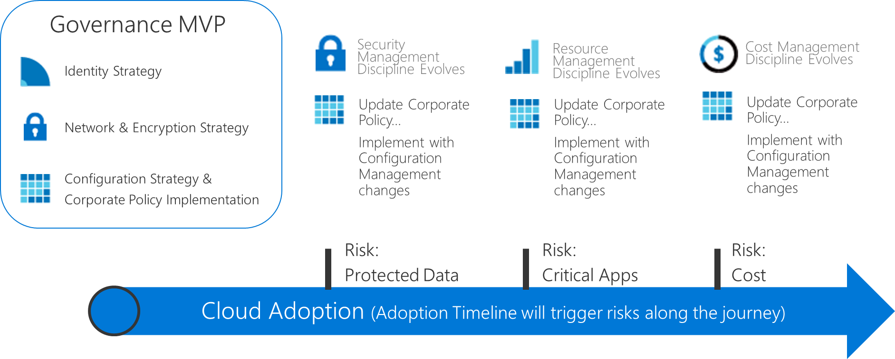
[Example]
Evolving the MVP: Protected Data
Discussion:
What changes or additions would you make to the “Governance-MVP”?
What other tools in Azure could be used to extend the MVP?
Notes:
Talk track:
The CAF model to governance is a way of approaching governance that allows us to decompose complex and emotional topics into smaller units of actionable change.
In the sections on Defining Corporate Policy, we change the topic from alignment to current IT governance requirements to a realistic look at tangible risks created by cloud adoption. Those risks can generate policy & compliance statements and recurring processes, which augment existing IT Governance Policy.
Actioning on those policy statements, is done in one of five buckets of activity that span the governance conversations. In each of the five disciplines, the Cloud Governance Team leverages the Configuration Management capabilities of the Azure Govern and Azure Manage tools to help IT Governance, IT Security, Identity, and Networking teams apply requirements consistently across all Azure adoption.
In this session, we will focus on the tools that establish a foundation for governance in Azure, which can be used to accelerate all five disciplines. These tools will aid in ensuring that the requirements of each discipline is consistently applied, audited, & enforced.
Corporate Policy
Data Breach is the primary risk.
All policy statements should focus on reducing the risk of breach through segmentation, isolation, authentication control, etc…
Risk Discovered
Adoption plans now include a need to host protected data in the cloud. This data is sensitive but not governed by 3rd party compliance.
Suggestions:
This could consume a lot of time.
The time could be higher for those that are not native English speakers
Where is the reference materials to help them think through potential solutions

Slide 32
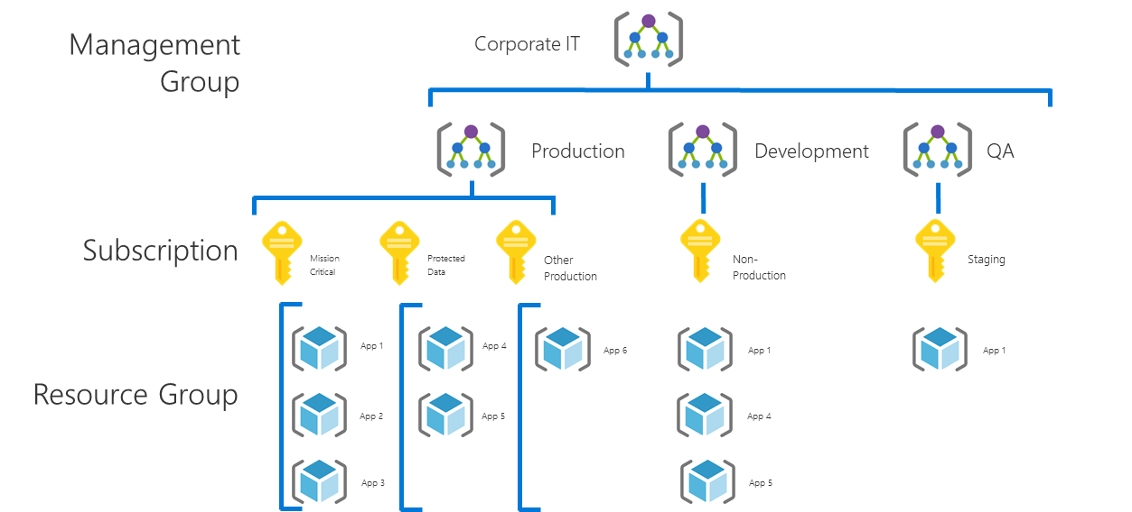
[Example]
Evolving the MVP: Cost Control
Current State MVP
Discussion
What changes or additions would you make to the “Governance-MVP”?
What other tools in Azure could be used to extend the MVP?
How do you reduce the risk of extra spend in the future using policies?
Azure Blueprint named “Governance-MVP” .
Azure Policy as follows:
Resource tagging require values for Department/Billing Unit, Geography, Data Classification, Criticality, SLA, Environment, Application Archetype, Application, and Application Owner.
The value of the Application tag should match the name of the resource group.
Notes:
Risk discovered
Costs are mushrooming. The CFO is concerned with budget overrun. A report is needed to show spend by business unit. Controls are needed to limit expenses.
Review and adjust this pattern to fit before presenting to the customer.

Slide 33
[Example]
Governance Design Evolution
A few options to consider
Implement Azure Security Center
Automate Patching to ensure patch compliance
Policy
Require encryption on storage accounts
Enforce application tier vNets
Enforce NSGs at each tier
Block User Defined Routing
Apply Guest Configuration policies
ARM Templates
Define a firewall configuration
Blueprint
Apply ASC, Policy, and ARM configurations

Slide 34
[Example]
Governance Design Evolution
More options to consider
Report spend by Business Unit
Generate Azure Cost Management (&/or Cloudyn) reports grouped by the Business Unit tag.
Reduce overall spend
If possible, start with a review of AHUB and RI options for immediate potential cost reductions.
Review Azure Advisor and Azure Cost Management feedback to suggest tuning options to each application owner.
Generally, a holistic review of spend will identify a few key SKUs that are consuming a large percentage of the Azure costs. Suggest the application owners begin by tuning those large instances.
Bonus Points: Reduce Future Spend
Once re-sized, avoid future spend by creating an Azure policy to block the use of any unused SKUs that have a higher unit cost.
If the governance team has a strong relationship and regular cadence with cloud adoption teams, a second suggestion could prove valuable. For all prod subscriptions, establish a deployment plan including the SKUs to be deployed. Block the use of any SKU not on the deployment plan. This reduces overspending from unplanned vertical scaling. This approach also promotes the use of more easily automated horizontal scaling.

Slide 35
Partner offering slides to continue the governance conversation

Slide 36
Closing

Slide 37
Partner proposed next steps

Slide 38
References to keep going
Framework
Frame the conversation to mitigate tangible business risks through consistent governance
1
https://aka.ms/adopt/govern
https://aka.ms/adopt/govern
Assess
Assess current state and future state to establish a vision for applying the framework
2
https://aka.ms/adopt/gov/Assess
https://aka.ms/adopt/gov/Assess
MVP
Establish a Minimally Viable Product (MVP) to serve as a foundation for governance
3
https://aka.ms/adopt/gov/MVP
https://aka.ms/adopt/gov/MVP
Evolve
Mature with each release to align Cloud Adoption and existing IT functions
4
https://aka.ms/adopt/gov/journey
https://aka.ms/adopt/gov/journey

Slide 39
Thank You

